Slide 1

Data Exchange Framework (DxF)
Implementation Advisory Committee (IAC)
December 4, 2025
9:00-10:00 am

Slide 2

Meeting Participation Options
Members are strongly encouraged to enable their video to foster increased interaction and discussion.
Please email Akira Vang (akira.vang@hcai.ca.gov) with any technical or logistical questions about meeting participation.

Slide 3
Meeting Participation Options Written Comments
Participants may submit comments and questions through the Zoom Q&A box; all comments will be recorded and reviewed by DxF staff.
Participants may also submit comments and questions – as well as requests to receive Data Exchange Framework updates – to DxF@hcai.ca.gov.
Questions that require follow-up should be sent to DxF@hcai.ca.gov.

Slide 4
Meeting Participation Options Spoken Comments
Public participants must “raise their hand” for Zoom facilitators to unmute them to share comments; the Chair will notify participants/Members of the appropriate time to volunteer feedback.
Offsite
Logged into Zoom
Phone Only
If you logged on from offsite via Zoom interface Press “Raise Hand” in the “Reactions” button on the screen If selected to share your comment, you will receive a request to “unmute;” please ensure you accept before speaking
If you logged on via phone-only Press “*9” on your phone to “raise your hand” Listen for your phone number to be called by moderator If selected to share your comment, please ensure you are “unmuted’ on your phone by pressing “*6”

Slide 5
Public Comment Opportunities
Public comment will be taken during the meeting at designated times.
Public comment will be limited to the total amount of time allocated for public comment on particular issues.
The Chair will call on individuals in the order in which their hands were raised.
Individuals will be recognized for up to two minutes and are asked to state their name and organizational affiliation at the top of their statements.
Participants are encouraged to use the comment box to ensure all feedback is captured or email their comments to DxF@hcai.ca.gov.

Slide 6
Agenda
9:00 AM Welcome
9:35 AM DxF Impact Measurement
9:10 AM Overview of Senate Bill (SB) 660
9:50 AM Public Comment
9:25 AM Policy and Procedure Amendments
9:55 AM Closing Remarks

Slide 7
Speaker Introductions
Scott Christman
Mike Valle
Jacob Parkinson
Chief Deputy Director, HCAI
Deputy Director and Chief Information Officer, HCAI
DxF Program Director, HCAI
Cindy Bero
Rim Cothren
Senior Advisor, Manatt Health Strategies
Independent HIE Consultant, HCAI

Slide 8
Welcome and DxF Vision

Slide 9

The Vision for Data Exchange in California
Every Californian, no matter where they live, should be able to walk into a doctor’s office, a county social services agency, or an emergency room and be assured that their health and social services providers can access the information they need to provide safe, effective, whole-person care—while keeping their data private and secure.​
​
California’s Data Exchange Framework (DxF) will help achieve this vision and improve care for all Californians by enabling statewide, secure data exchange between health and social services providers.

Slide 10
Overview of SB 660

Slide 11
Overview of Senate Bill (SB) 660
SB 660 (Chapter 412, Statutes of 2025), signed by Governor Newsom in October 2025, strengthens and expands the DxF by:
Making HCAI the administrator of the DxF program;
Clarifying definitions for “physician organizations and medical groups” and requiring Emergency Medical Services to execute the Data Sharing Agreement (DSA) and begin data exchange;
Codifying the process to designate Qualified Health Information Organizations (QHIOs) into state law;
Beginning July 1, 2026, making DSA execution a required condition of contracting with the Department of Health Care Services, the Public Employees’ Retirement System, and the California Health Benefit Exchange for required signatories;
Beginning January 1, 2027, requiring HCAI to publish and regularly update a list of required signatories that may be out of compliance with signing the Data Sharing Agreement; HCAI may refer non-compliant entities to the relevant state licensing agency;
Allowing HCAI to develop further enforcement actions, pending input from the stakeholder advisory committee and upon appropriation from the Legislature; and
Strengthening DxF stakeholder governance by broadening stakeholder advisory committee membership and expanding the committee's responsibilities.

Slide 12
Policy and Procedure Amendments

Slide 13
Technical Requirements for Exchange P&P September IAC Discussion Recap
HCAI solicited feedback at the last IAC meeting on two issues raised in public comment on the Technical Requirements for Exchange Amendment.
Item | IAC Meeting Feedback | Decision
Requiring Event Notifications from Skilled Nursing Facilities (SNFs) | Notifications of admissions and discharges from SNFs are critical to care coordination through care transitions. Many stakeholders, including California Association of Health Facilities (CAHF), expressed support for a requirement for SNFs that have the capability. Many SNFs do not have electronic health records (EHRs); the number of SNFs with EHRs is disputed and uncertain. January 1, 2027, may be too soon for SNFs without an EHR. | Pending decision.
Human-Readable Notifications | Lack of a requirement for providing human-readable notifications is not an issue for most DxF Participants. Some QHIOs support human readable notifications, but some do not. Requiring human readable notifications without state support would create a burden for some Participants. | Do not require human-readable notifications.

Slide 14
Technical Requirements for Exchange P&P Amendment Summary
Based on all input and feedback received, HCAI intends to release the amended Technical Requirements for Exchange Amendment in early 2026.
Request for Information and Information Delivery |  | Remove specification of technical standard when using a Nationwide Network or Framework Clarify that this P&P does not limit Participants’ ability to use a Nationwide Network or Framework to meet some or all DxF obligations
Event Notification | Language | Transition use of defined terms from “Notifications of ADT Events” to “Event Notification” Define several new terms for Events, Admissions, Discharges, Event Notifications, etc.
 | Standards | Establish data content requirements for Event Notifications Require Event Notifications to be sent in HL7 v2.5.1 (or later) ADT message format Require Event Notifications to use of a National and Federally Recognized Standard for transport
 | Rosters | Define Roster as list of identities using person attributes described in Person Matching Require Roster to include Required Purpose and name of requesting Participant
 | SNFs | Pending decision.
Person Matching |  | Prohibit the use of sex- or gender-related attributes unless required by the underlying technical specification or by a Nationwide Network
Legal Requirements |  | P&P does not limit the responsibility of Participants to execute agreements, such as BAAs, as required by applicable law when using an Intermediary P&P does not limit Participants' legal and compliance accountability when using an Intermediary

Slide 15
Policy and Procedure Amendments P&P Amendments to Align with SB 660
Item | SB 660 Change | Proposed P&P Amendment(s)
Information that May Be Excluded from Required Exchange | SB 660 adds information about “gender-affirming care, immigration or citizenship status, or place of birth” to the categories of information that are not required to be exchanged under the DxF. | Reflect the updated list of information that may be excluded from required exchange in the following P&Ps: Data Elements to Be Exchanged Permitted, Required, and Prohibited Purposes Privacy Standards and Security Safeguards
Newly Required DSA Signatories | SB 660 clarifies the definition of physician organizations and medical groups (POMGs) and updates the timeline by which some of those organizations are required to sign the DSA. Further SB 660 adds EMS as required signatories. | Add the new July 1, 2026 dates to exchange for EMS and one POMG in the Requirement to Exchange Health and Social Services Information P&P.
By When Information Must Be Shared | SB 660 permits medical foundations that are exempt from licensure pursuant to subdivision (I) of Health and Safety Code (HSC) section 1206 and emergency medical services as defined in (HSC) section 1797.72 to delay executing the DSA and exchanging information until July 1, 2026, and permits facilities described in subdivision (a) of (HSC) section 1180.2 (i.e., DSH and DDS facilities that utilize seclusion or behavioral restraints) to delay exchange until January 31, 2029 (DSH was previously permitted to delay exchange until January 31, 2026). | Reflect the options to delay exchange until July 1, 2026 (EMS, medical foundations) and January 31, 2029 (DSH and DDS facilities that utilize seclusion or behavioral restraints) in the following P&Ps: Participant Directory Requirement to Exchange HSSI

Slide 16
DxF Impact Measurement

Slide 17
Impact Measurement
DSA Participant Growth: 2022-2025

Slide 18
Impact Measurement DxF Participants
As of November 30, 2025, DxF includes 4,765 Participants.
These Participants represent a wide range of health and social service organizations.
The largest group - Ambulatory Care Settings - represents 43% of all Participants.
“Other” includes Community-based Organizations, EMS Providers, Counties and Intermediaries

Slide 19
Impact Measurement
DSA Participant Directory
Progress continues with more than 70% of active DxF Participants completing their selections in the Participant Directory.

Slide 20
Impact Measurement DxF QHIO Program
In 2023, DxF identified nine Qualified Health Information Organizations (QHIOs) to assist DxF Participants across the state with data exchange.
Through their Participant Directory selections, 2/3rds of Participants have identified a QHIO who supports their DxF exchange.
Of note, in the past 15 months, the number of Participants accessing QHIO services for event notification more than doubled.
"For our CCBHC team, partnering with a local FQHC and not being integrated into their EHR system, leveraging an HIE has been instrumental in being able to see customer's full medical history and for our prescribers to make appropriate Rx recommendations. Otherwise, we had been securely faxing customer information and not getting a full picture.“
Pacific Clinics

Slide 21
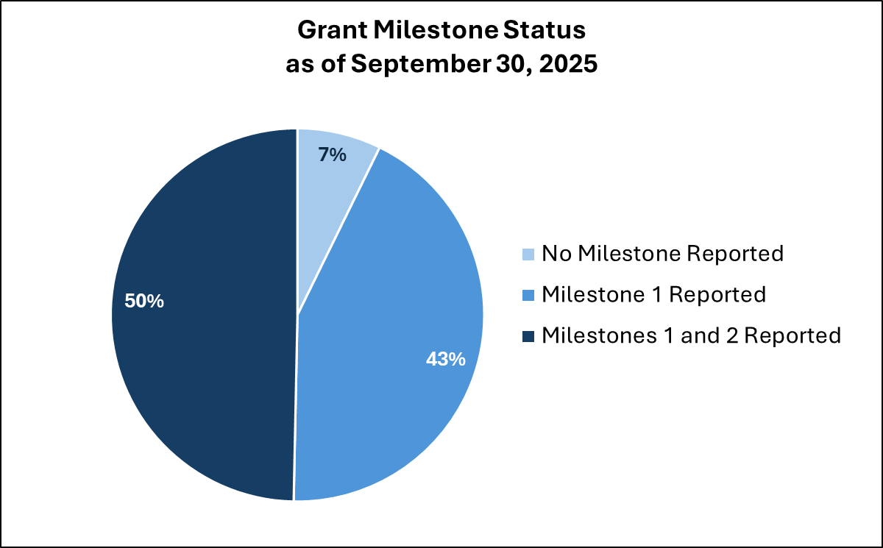
Impact Measurement DSA Signatory Grants
The DxF Educational Initiative Grant Program awarded $3 million to eight not-for-profit associations and organizations to provide education and training on the DxF in calendar year 2023. These grants supported a range of activities, from webinars and one-on-one coaching sessions, to the creation of a speaker’s bureau and learning collaboratives, reaching an estimated 10,000 individuals.
The DSA Signatory Grants Program awarded $40 million to help more than 750 DSA Signatories meet their DxF requirements. Grant funding began in 2024 with additional disbursements expected to continue through 2026 as grantees achieve payment milestones.

Slide 22
Public Comment

Slide 23
Closing Remarks

Slide 24
DxF Webpage Resources
For more information on the DxF, please visit the DxF webpage.
There you can find:
The DxF, DSA, and P&Ps;
Information about the QHIO and DxF Grant programs;
Materials from previous and upcoming meetings, webinars, and listening sessions;
FAQs on the DxF;
Link to the DSA Signing Portal and Participant Directory; and
Weekly update to the DSA Signatory List that Includes Participant Directory Fields.
And more!

